Slide 1


Full Stack Web Development

Slide 2
Welcome
Full-stack die-hards would consider a full-stack developer to have specialized knowledge in all stages of software development.

Slide 3
Our Agenda
Back End
Questions
Introduction
Front End
Web Careers
3

Slide 4

Hi I’m Ahmed Elnemr
A Full-Stack Developer multi-disciplinary
Instructor ( 3+ years experience),
Full-Stack Developer ( 2+ years experience) ,
Desktop Developer ( 3+ years experience),
Database Designer ( 3+ years experience) ,and
Database Developer ( 3+ years experience)
YouTube : Elnemr Code
LinkedIn : Ahmed Elnemr
E-mail : pro.ahmedelnemr@gmail.com
Phone : 02 0100 529 675 53
4

Slide 5

Welcome
IDE Academy stands for IntelliJ Developing Education Academy Our Aim To Prepare New Generation Of Highly Trained Egyptian Developers
Practical Training is our slogan so we will work on each topic of the training program outline together in a practical way to ensure best practice
Web development was the first course we start with 3 years ago so we love all of web developers they was our head start
At the latest of 2017 we decide to add extra free marketing sessions to all of our courses to help all of our student to reach they goal
5

Slide 6
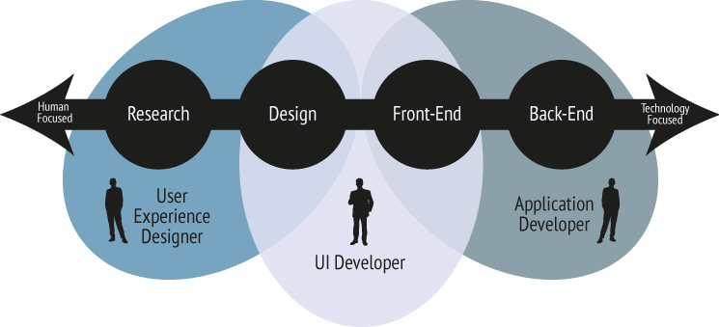
Web Development Careers

Slide 7

Web Development Careers

Slide 8
Course Roadmap
Trainee
Front-End
Learn the Basics
CSS
JavaScript
HTML
8

Slide 9
HTML
HTML is the standard markup language for creating Web pages.
9

Slide 10
HTML
HTML is the standard markup language for creating Web pages.
HTML stands for Hyper Text Markup Language.
HTML describes the structure of Web pages using markup.
HTML elements are the building blocks of HTML pages.
HTML elements are represented by tags.
HTML tags label pieces of content such as "heading", "paragraph", "table", and so on.
Browsers do not display the HTML tags, but use them to render the content of the page.
10

Slide 11
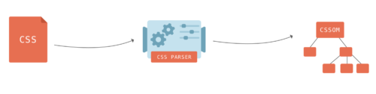
CSS
CSS stands for Cascading Style Sheets
11

Slide 12
CSS
CSS stands for Cascading Style Sheets
CSS is a language that describes the style of an HTML document.
CSS describes how HTML elements should be displayed.
12

Slide 13
JavaScript
JavaScript has become one of the most popular programming languages on the Web
13

Slide 14
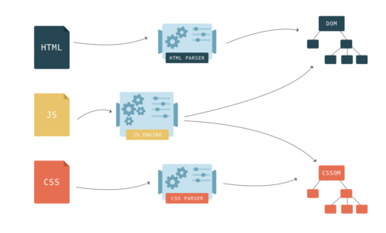
JavaScript
JavaScript has become one of the most popular programming languages on the Web
14

Slide 15
JavaScript
JavaScript has become one of the most popular programming languages on the Web
JavaScript is the programming language of HTML and the Web.
JavaScript is easy to learn.
15

Slide 16
Course Roadmap
Getting Deeper
CSS
JavaScript
Bootstrap
Materialize CSS
Foundation CSS
………………….
..
Flow DOM
JQuery
Ajax
16

Slide 17
Back-End
DBMS
PHP 7
Package Manager
Core PHP
Ajax
Frameworks
17

Slide 18


18

Slide 19
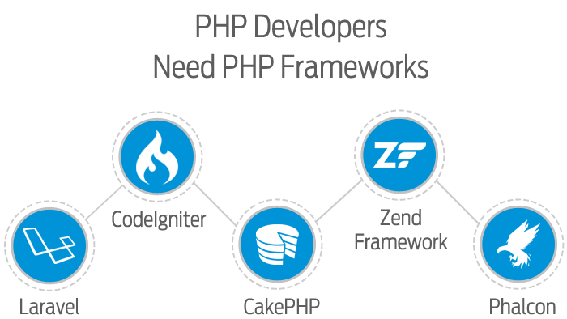

Slide 20




Slide 21


Slide 22
Get In Touch
Pro.ahmedelnemr@gmail.com
0100 52 967 53
facebook.com/deva7med
22

Slide 23
Good Day :D

